Slide 1

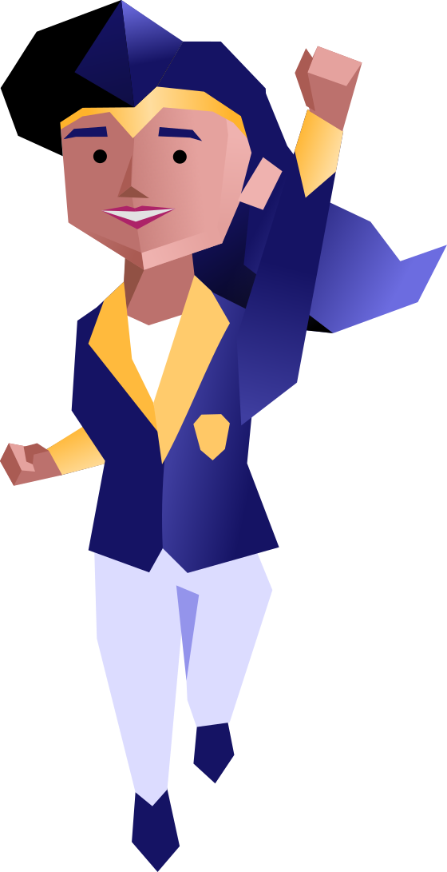

Security Champions
An OWASP SAMM
Level Booster
Dustin Lehr
Sept 2024
No AI was used in the creation of this content.
https://responsibleaidisclosure.com/

Slide 2


Who’s this guy anyway?

Slide 3





13 years as a Software Engineer and Architect…
(Avoided Talking)

Slide 4

… into Leadership …
Head of Application Security
Deputy CISO
(Lots of Talking)

Slide 5


… To Currently:
Co-founder, Chief Product & Technology Officer
Co-founder, Co-host
Let’s Talk Software Security Global Open Discussion Community

Slide 6

Author
https://securitychampionsuccessguide.org/

Slide 7
Takeaway!
Accelerating your SAMM Level-Up effort requires ,
which you can inspire through !

Slide 8
Takeaway!
Accelerating your SAMM Level-Up effort requires proactive action by PEOPLE ,
which you can inspire through !

Slide 9
Takeaway!
Accelerating your SAMM Level-Up effort requires proactive action by PEOPLE ,
which you can inspire through behavioral science !

Slide 10
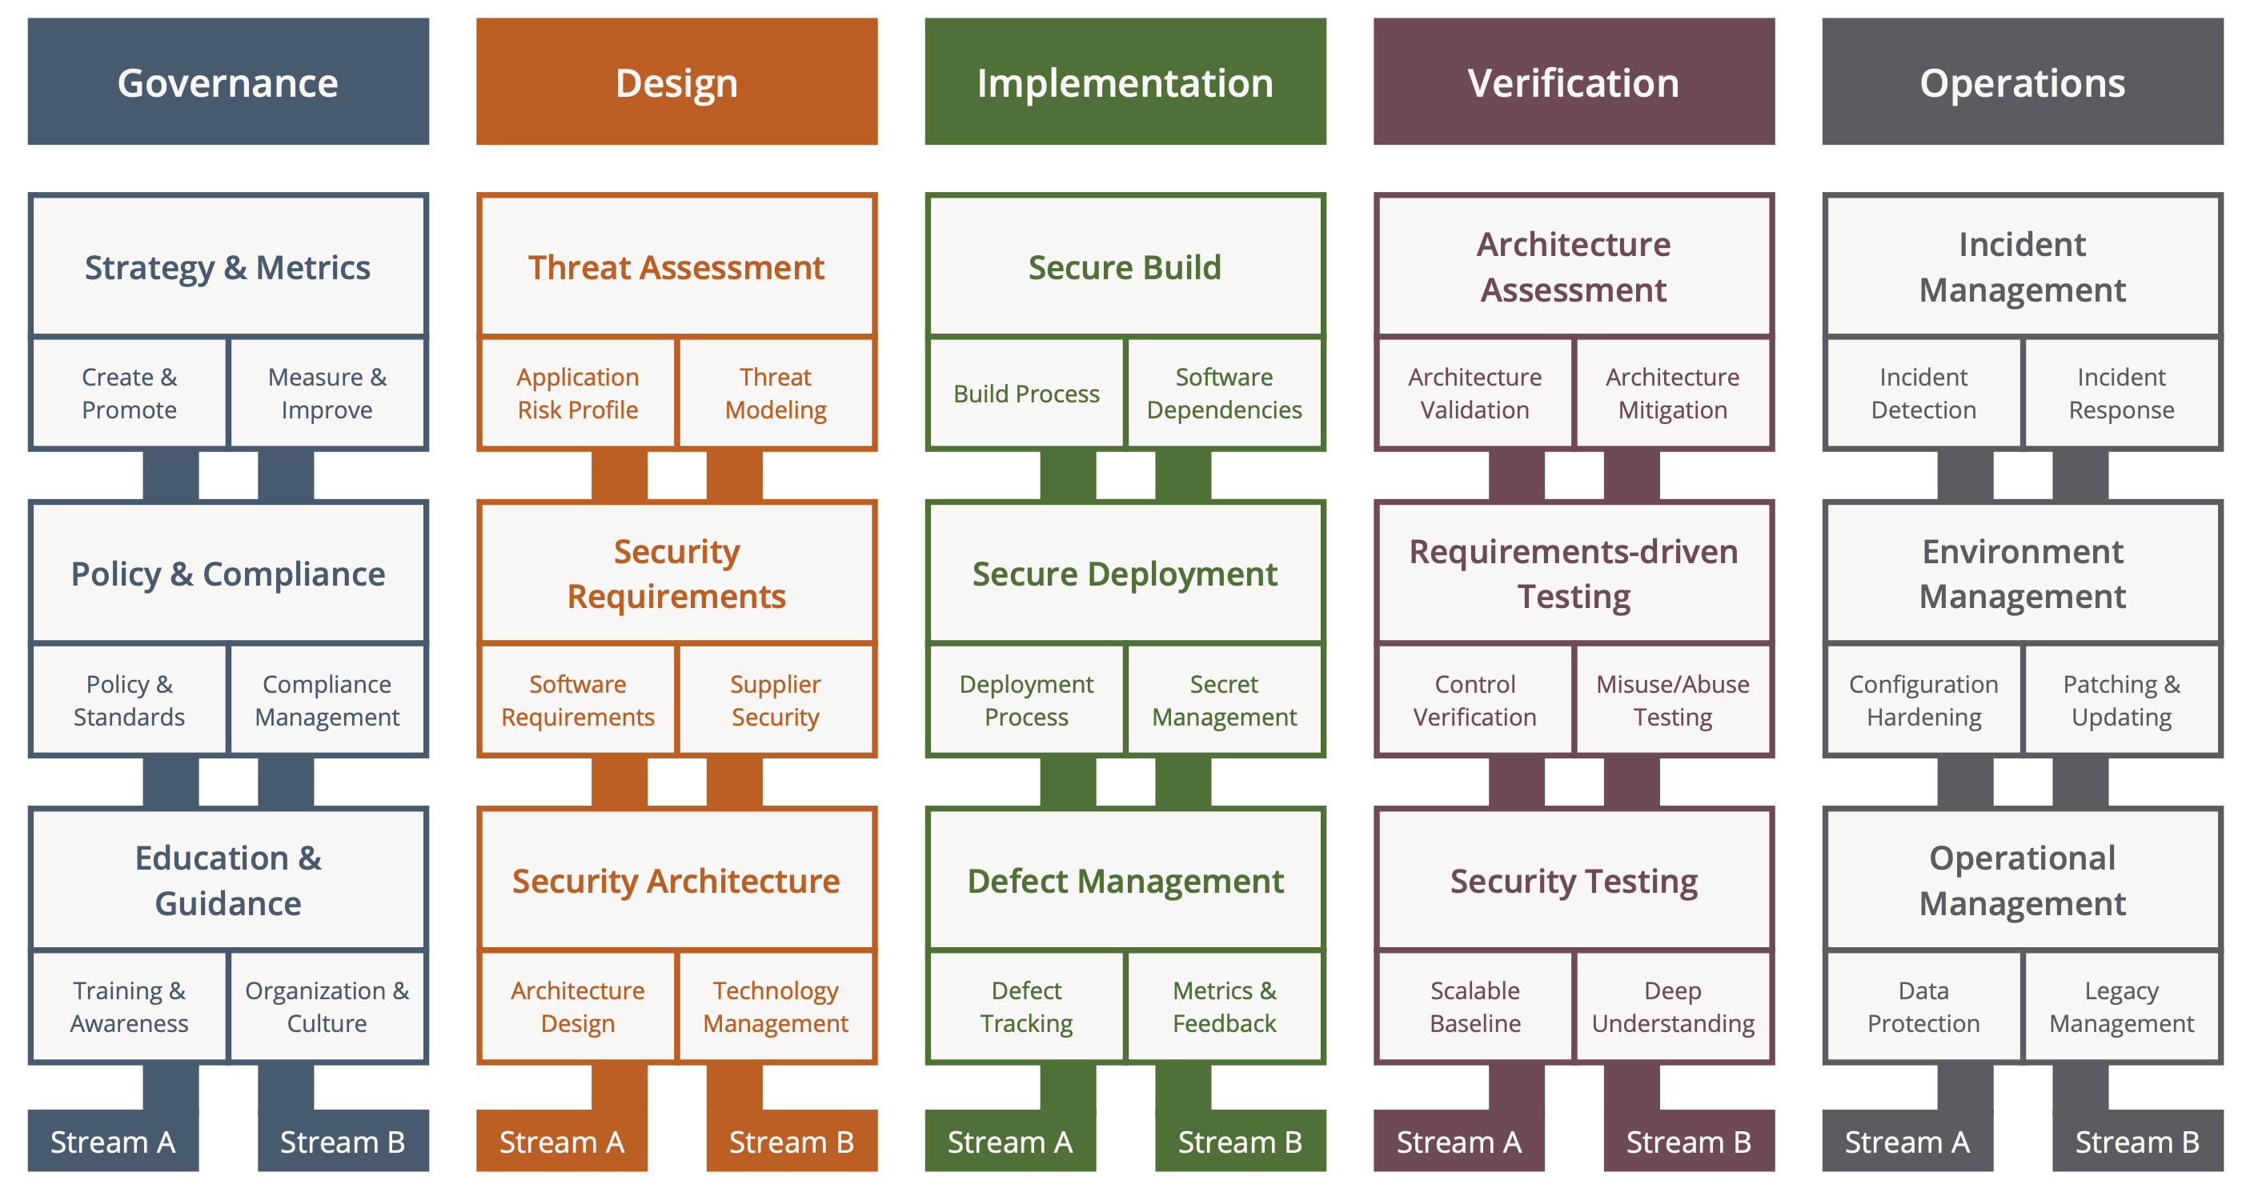
The OWASP SAMM

Slide 11
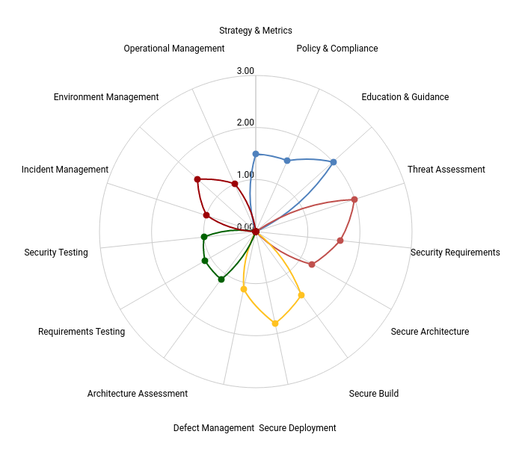
Assessment: are you where you want to be?

Slide 12
So… you want to CHANGE?

Slide 13
The security team cannot handle it all.
We need to influence others to take action.

Slide 14
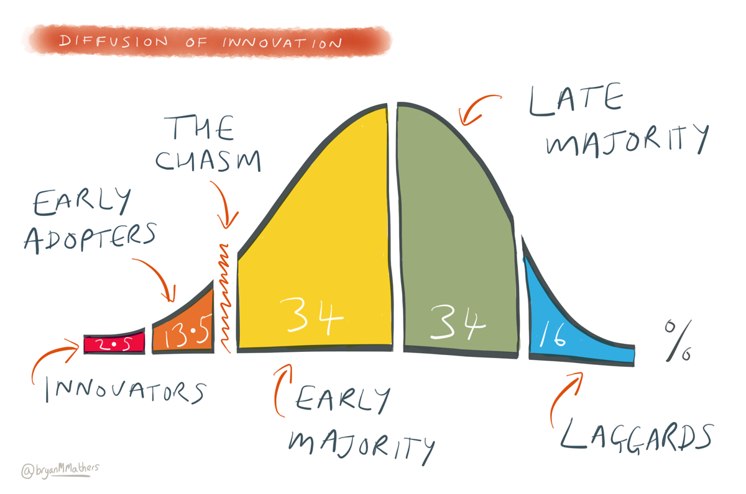
How CHANGE Catches On

Slide 15
Find your allies! Turn them into champions!

Slide 16
Why are early adopter allies so effective?
I know, it’s hard to hear:
People will listen more closely to non-security people whom they trust, than to YOU.
(Ouch…)

Slide 17
But people are hard… so…
Let’s just give up and focus on AI and tech!

Slide 18
NO! Don’t give up on people!
We can apply proven scientific methods from behavioral science to shift our cultures toward taking action.

Slide 19
Where Can Champs Contribute?

Slide 20
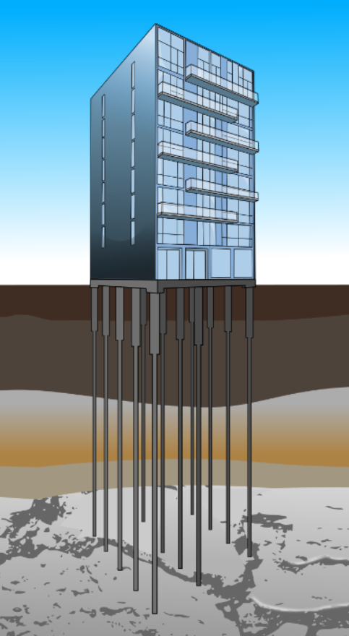
Maturity Requires a Strong Foundation
5. Prevent Risk
4. Fix Risk
3. Find Risk
2.Train & Educate
1. Connect and Build Relationships

Slide 21
What’s required to see behavior?
B
M
A
P
=
+
+
Behavior

Slide 22
What’s required to see behavior?
B
M
A
P
=
+
+
Behavior
Motivation

Slide 23
What’s required to see behavior?
B
M
A
P
=
+
+
Behavior
Motivation
Ability

Slide 24
A formula for behavior: BJ Fogg’s Behavior Model
B
M
A
P
=
+
+
Behavior
Motivation
Ability
Prompt

Slide 25
Your colleague’s behavior
B
M
A
P
=
+
+
Behavior
Motivation
Ability
Prompt
Attend Secure Coding Talk

Slide 26
Your colleague’s behavior
B
M
A
P
=
+
+
Behavior
Motivation
Ability
Prompt
Attend Secure Coding Talk
Curiosity, Relevant Topic, Suggested the Topic, Points for Attending,
Impress Boss, Invited by someone they respect

Slide 27
Your colleague’s behavior
B
M
A
P
=
+
+
Behavior
Motivation
Ability
Prompt
Attend Secure Coding Talk
Curiosity, Relevant Topic, Suggested the Topic, Points for Attending,
Impress Boss, Invited by someone they respect
Convenient Time, Video Call Link Available, Leadership encouraged

Slide 28
Your colleague’s behavior
B
M
A
P
=
+
+
Behavior
Motivation
Ability
Prompt
Attend Secure Coding Talk
Curiosity, Relevant Topic, Suggested the Topic, Points for Attending,
Impress Boss, Invited by someone they respect
Convenient Time, Video Call Link Available, Leadership encouraged
On Calendar, Reminders Sent On Slack

Slide 29
Focus: Motivation

Slide 30
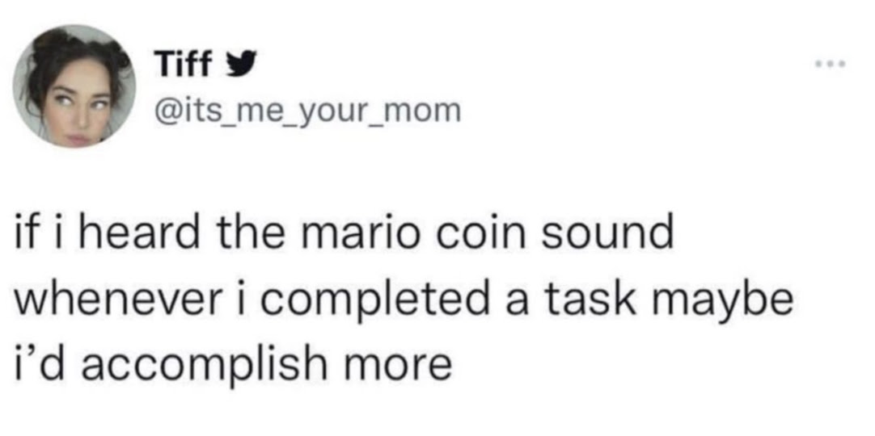

Slide 31
“Gamification” isn’t about turning an experience into a game, it’s about using game techniques in non-game situations.

Slide 32
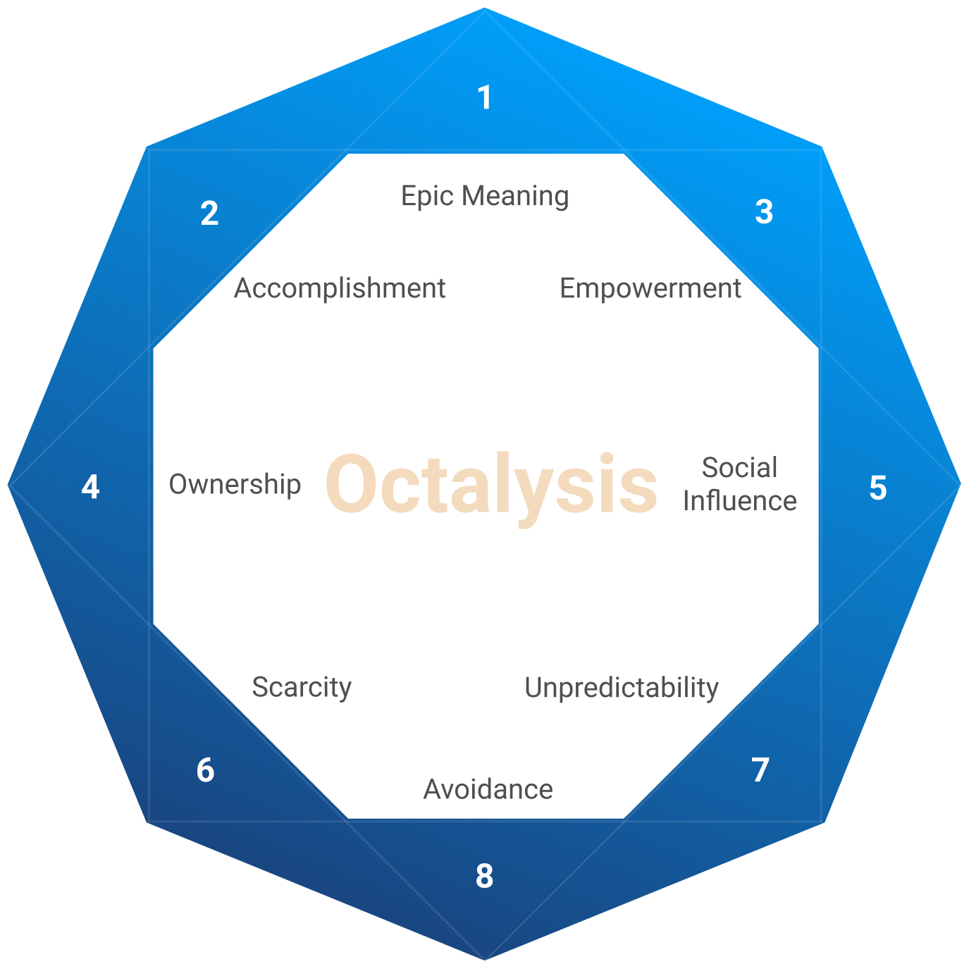
Understanding Human Core Drives / Motivators

Slide 33
Extrinsic vs. Intrinsic Motivation
Extrinsic Depends on Reward
Intrinsic Rewarding
In Itself

Slide 34
Sustainability vs. Urgency
Sustainable, Not Urgent
Urgent, Not Sustainable

Slide 35
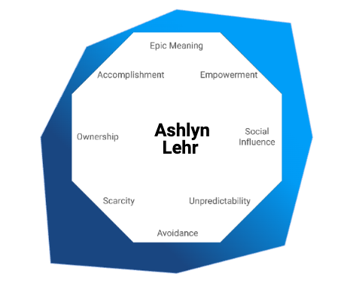
Not everyone is motivated the same
5yo Girl
Lehr Cub

Slide 36
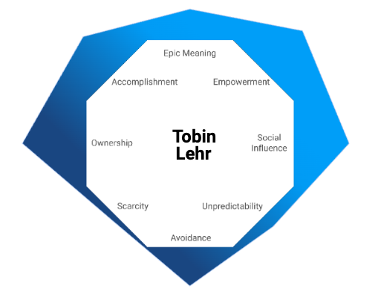
Not everyone is motivated the same
8yo Boy
Lehr Cub

Slide 37
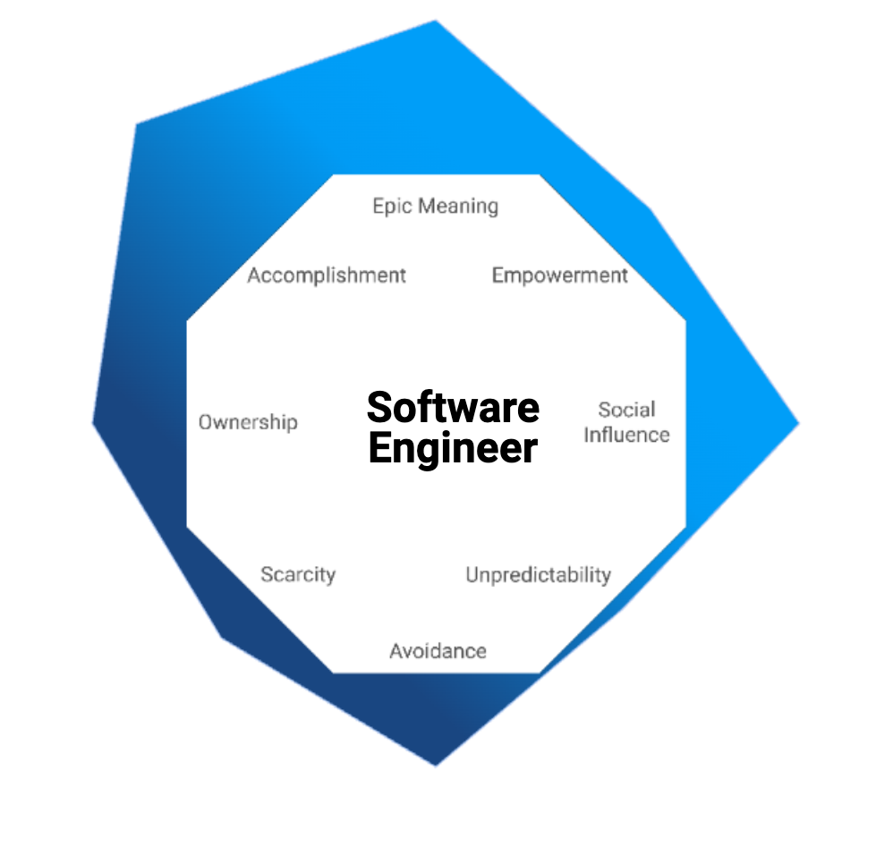
Not everyone is motivated the same

Slide 38
Not everyone is motivated the same
Heavy on Accomplishment and Social Influence… Is this why security champion belt levels work so well?

Slide 39
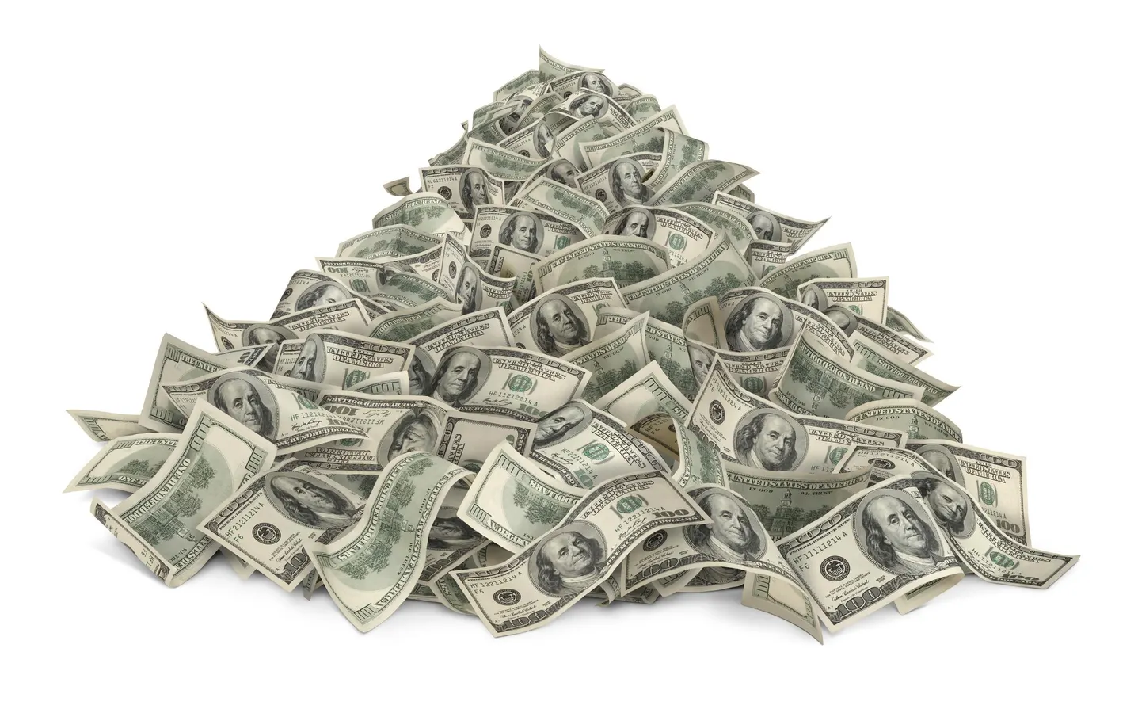

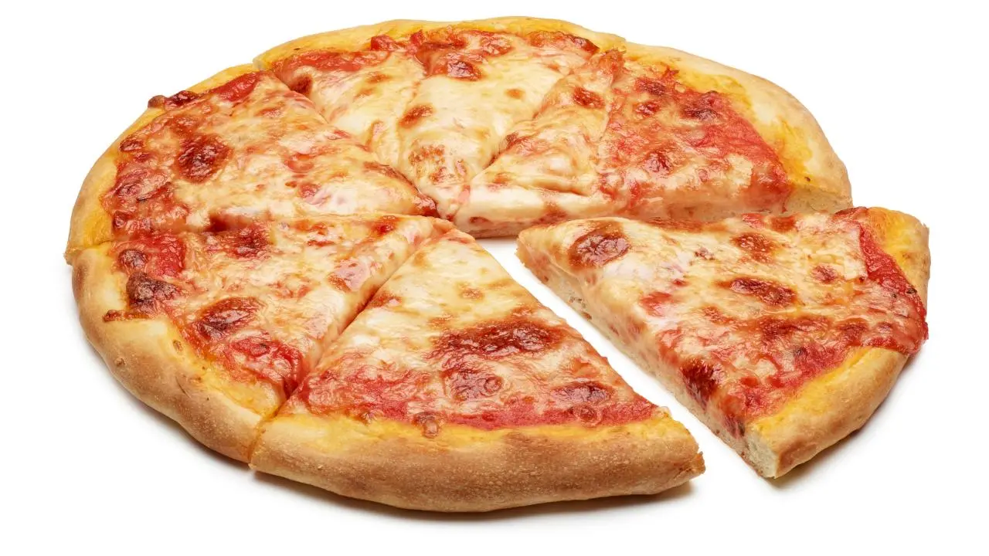
Rewards!
Just money and SWAG, right?? Oh, and PIZZA?

Slide 40
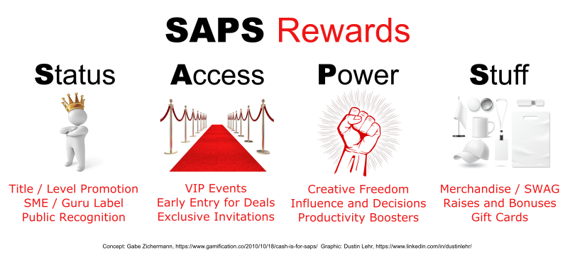
Get creative!

Slide 41
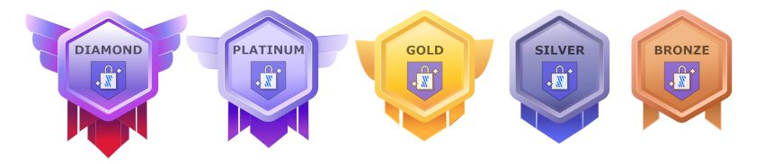
Engineering Team Maturity Medals
A single score based on a combo of weighted metrics (VM, champions, design reviews, TM)

Slide 42
Takeaway!
Accelerating your SAMM Level-Up effort requires ,
which you can inspire through !

Slide 43
Takeaway!
Accelerating your SAMM Level-Up effort requires proactive action by PEOPLE ,
which you can inspire through !

Slide 44
Takeaway!
Accelerating your SAMM Level-Up effort requires proactive action by PEOPLE ,
which you can inspire through behavioral science !

Slide 45
Bonus Takeaway!
The more fun and excitement you bring to your change initiative, the more you will inspire others to get involved!

Slide 46
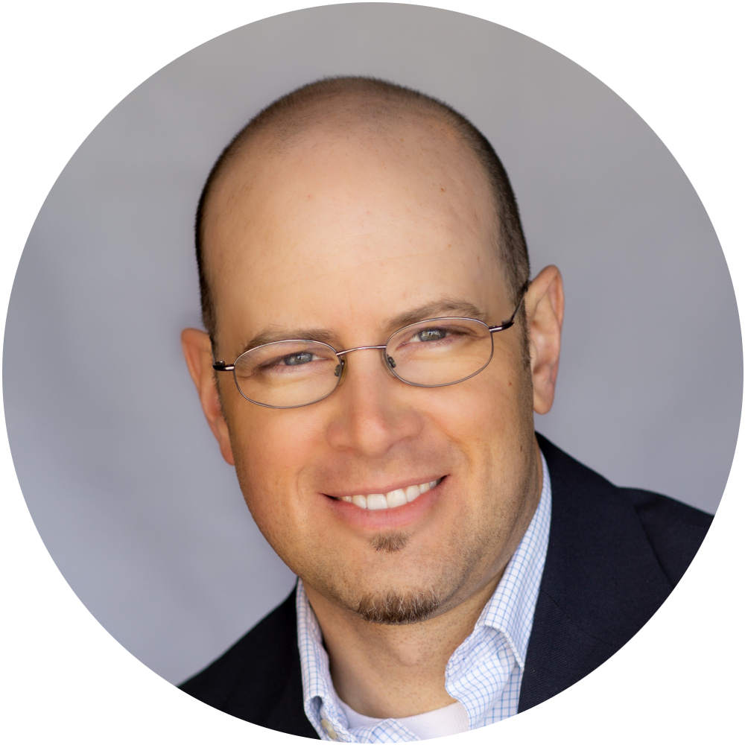
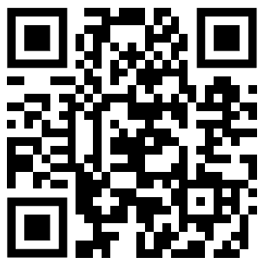
Thank you! Questions?
Dustin Lehr
Connect with me on LinkedIn!
https://www.linkedin.com/in/dustinlehr/
Or, just scan this (it’s safe!)

Slide 47
APPENDIX

Slide 48

Putting it all together!

Slide 49

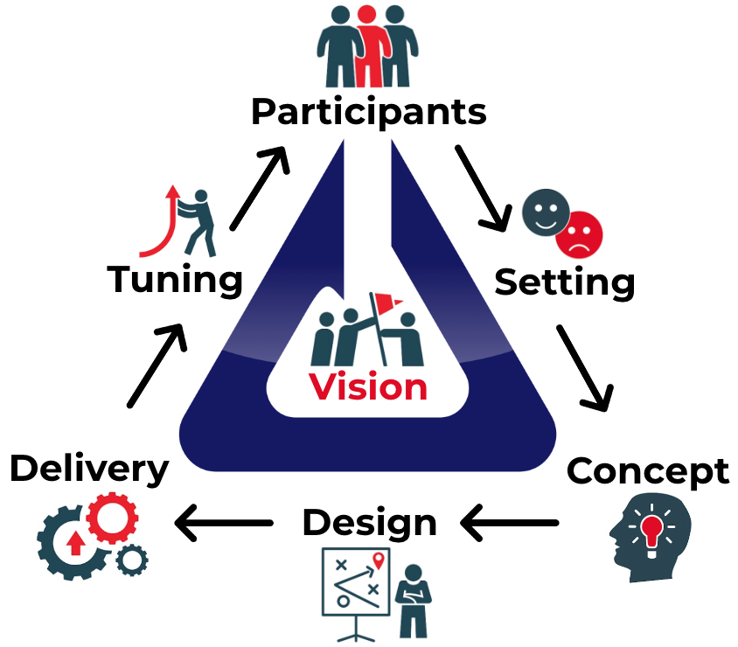

Slide 50
Fivetran’s Motivational Design
Feature | Motivation
Earn Points for Actions | CD2: Accomplishment, CD3: Empowerment
Points determine Security Belt Level | CD2: Accomplishment, CD5: Social Influence
Level-Ups bring recognition & rewards | CD2: Accomplishment, CD7: Scarcity
Points Last 1 Year, Level May Drop | CD8: Loss
Below Highest Level, 2x Points for Actions | CD2: Accomplishment, CD4: Ownership
Mentors get Half the Points of their Mentees | CD2: Accomplishment, CD5: Social Influence

Slide 51
Success Stories
Black Belt Started a Security Focus Group Black Belt started a Book Club, Lock-Picking Workshop Black Belt started and ran a Newsletter Promotions list involvement in the champions program for justification Teams thinking of their own ways to utilize the champions
** Can you imagine forcing this?? This must be inspired. **

Slide 52
Fivetran Stats
Champs 2.4x more likely to report phishing emails
Champs 11.5x more likely to report security issues

Slide 53
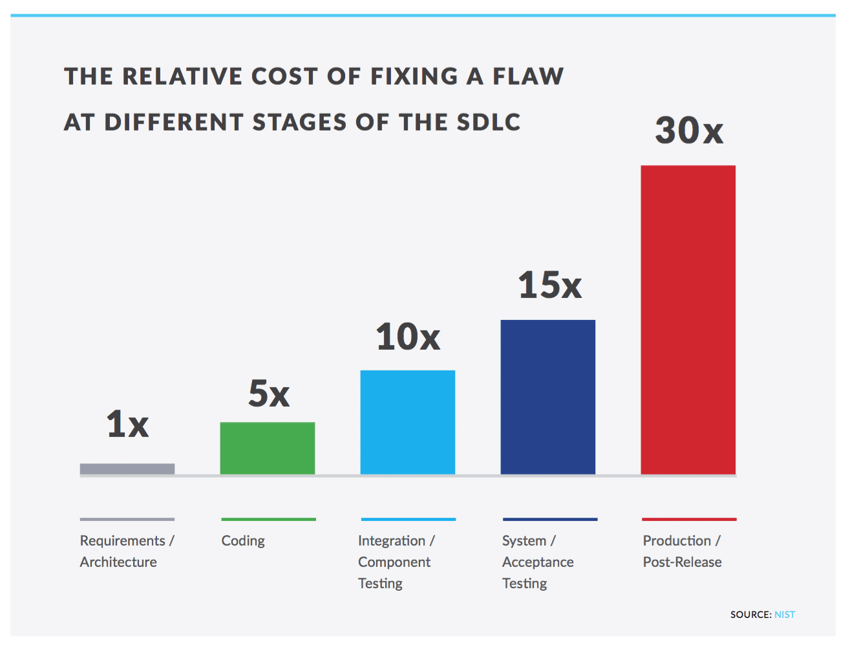
The business reason for being proactive

Slide 54
"I don't think large companies would put too much credence in incentives and motivation as a way to gain adoption. They hire professionals to do a job.”
-- Someone I met recently

Slide 55
Gamification Case Studies
List of 90+ Gamification Examples & Cases with ROI Stats: https://yukaichou.com/gamification-examples/gamification-stats-figures/
Example:
Employee Engagement: Caixa increased bank recurring profits by 46% (+$1.06 Billion USD) by gamifying workforce productivity of 76,000 employees across 6 departments.

Slide 56
Abstract
Security Champions: An OWASP SAMM Level Booster
Measuring the software security posture of your company using OWASP's Software Assurance Maturity Model is a tried-and-true method for identifying strengths as well as gaps and opportunities in strategy and approach, but once these opportunities are identified... HOW should they be addressed? At that point, the conversation is about CHANGE... changing your culture, engineering habits, processes, and ultimately winning hearts and minds to the cause of maturing your security posture.So, what are the best and most effective ways to pursue the CHANGE at your organization?One necessary step toward change is finding allies who can become advocates for the change you are pursuing, and the concept of "security champions" is well known and widely used model in application security. In this talk, I'll provide tips and tricks for how to motivate your champions to get involved in the context of the OWASP SAMM.We'll discuss: - How can an effective security champion program become a force multiplier of security culture change? - What specific practices of the SAMM can an effective champions program assist in maturing? - What can we learn from behavioral science to better understand human motivation to inspire your colleagues to take action?

Slide 57
Bonus Takeaway!
The more fun and excitement you bring to your culture change initiative, the more you will inspire others to get involved!

Slide 58

Core Drive 1: Epic Meaning & Calling
Higher Purpose
Help Humanity

Slide 59
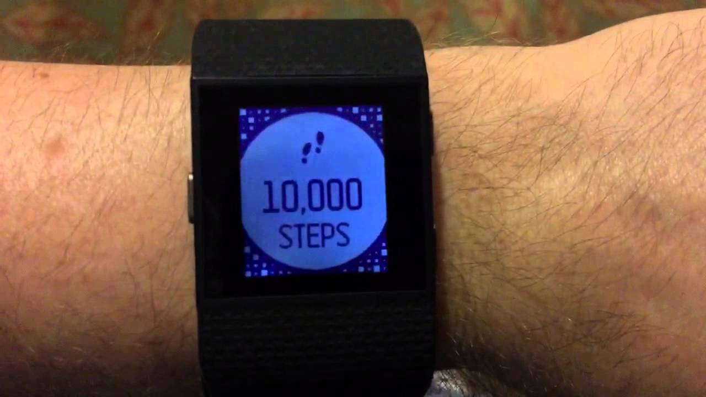
Core Drive 2: Development & Accomplishment
Achievement of a Challenge
Overcome, Prevail, earn Something

Slide 60

Core Drive 3: Empowerment of Creativity & Feedback
Apply Your Uniqueness
Contribute and Make Decisions

Slide 61
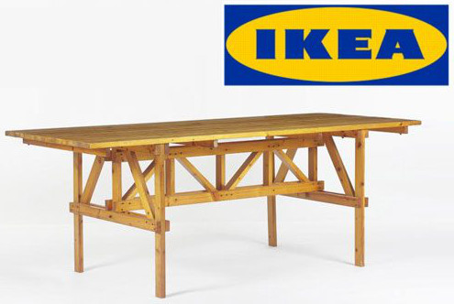
Core Drive 4: Ownership & Possession
Pride In What We Own
We want to take care of, and improve, our things

Slide 62
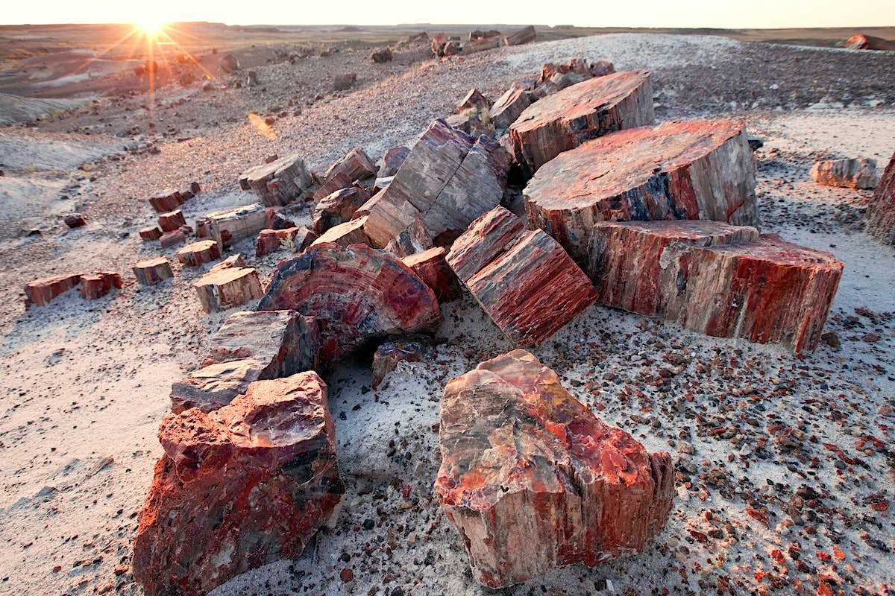
Core Drive 5: Social Influence & Relatedness
Desire To Please, and Rise Above, Others
Our Survival is Tied to the Group

Slide 63

Core Drive 6: Scarcity & Impatience
Abundance is Not Motivating
We want what we cannot have

Slide 64

Core Drive 7: Unpredictability & Curiosity
What happens next??
We must know what we don’t know!

Slide 65
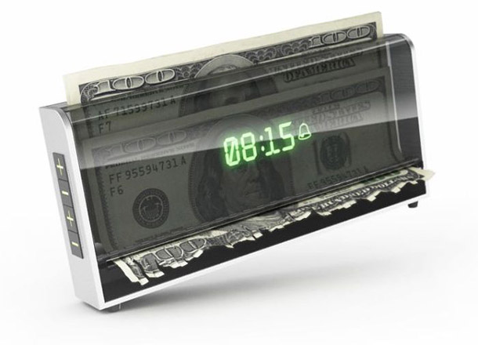
Core Drive 8: Loss & Avoidance
Fear of Losing Something
It’s hard to quit what you’ve put so much into

Slide 66
Characters and Icons
Avatars & Icons: https://drive.google.com/drive/folders/1tAQUG92iKXOA38f2D6hTmlTgBvBuwXRE?usp=drive_link

Slide 67
Who’s this guy anyway?

Slide 68
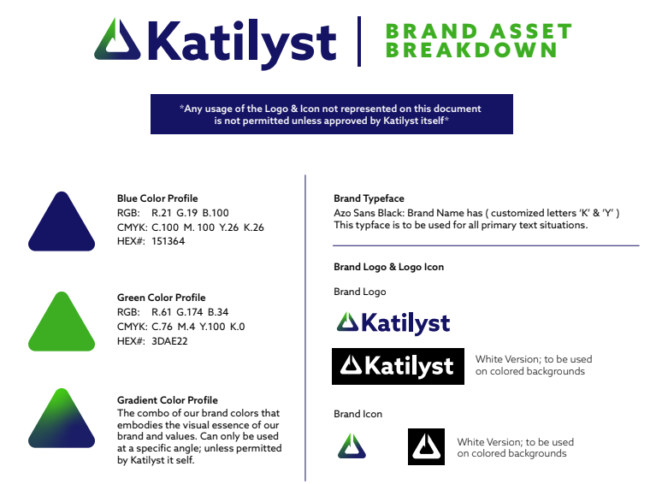
Slide progression bar

Slide 69

Inspiring employees to take action
New York, Usa ©2025

Slide 70
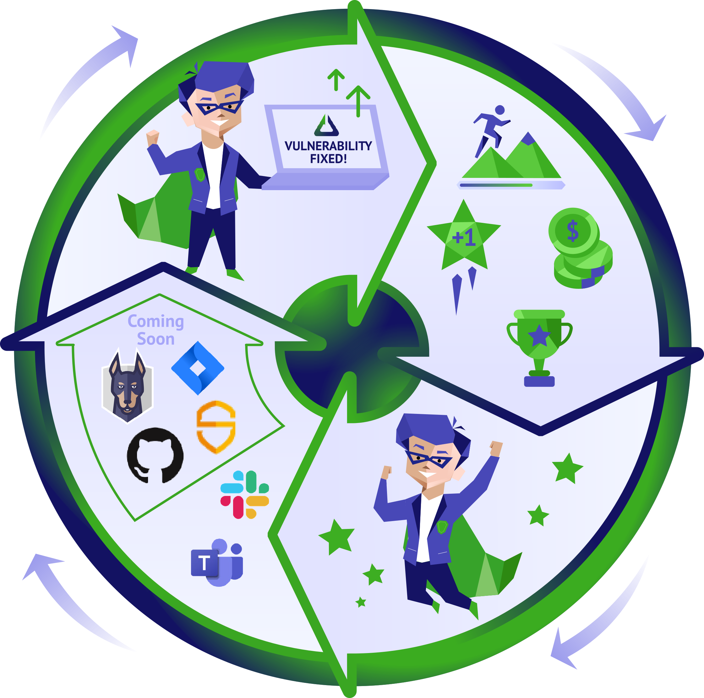
Katilyst powers the Security Champion ecosystem
Katilyst Detects Actions In Tools
Katilyst Tracks and Rewards Actions
Champions Take Actions In Tools
Rewards Encourage Champions to
Take Action

Slide 71


Slide 72
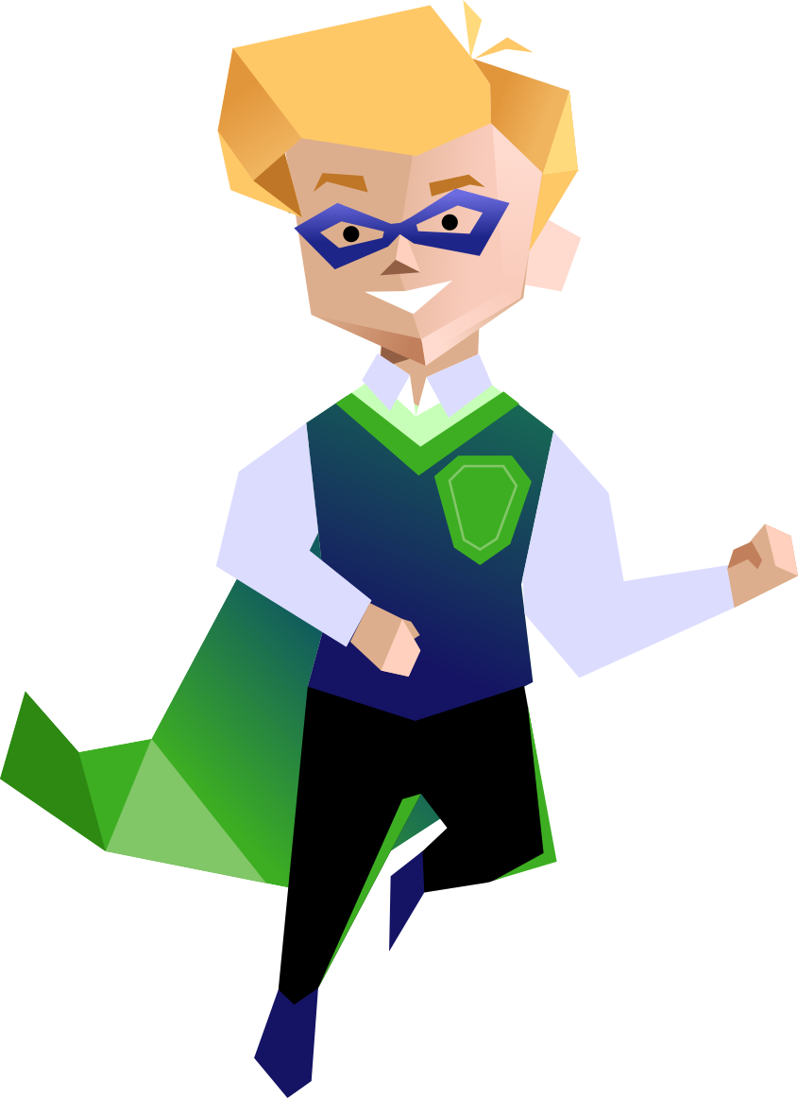






Katilyst automates program rewards that incentivize security-minded actions
We power…
Configurable Program Rules
Integrations
Program Insights
So you can…
Save time managing the program
Confirm secure behaviors are adopted
Correlate Champion activity to security goals

